Slide 1
The Manifesto for
Agile Software Development
“We are uncovering better ways of developing software by doing it and helping others do it. Through this work we have come to value:
  Individuals and interactions over processes and tools
  Working software over comprehensive documentation
  Customer collaboration over contract negotiation
  Responding to change over following a plan
That is, while there is value in the items on the right, we value the items on the left more.”

Slide 2
What is “Agility”?
Effective (rapid and adaptive) response to change
Effective communication among all stakeholders
Drawing the customer onto the team
Organizing a team so that it is in control of the work performed
Yielding …
Rapid, incremental delivery of software

Slide 3

Agility and the Cost of Change

Slide 4
An Agile Process
Is driven by customer descriptions of what is required (scenarios)
Recognizes that plans are short-lived
Develops software iteratively with a heavy emphasis on construction activities
Delivers multiple ‘software increments’
Adapts as changes occur

Slide 5
Agility Principles - I
1. Our highest priority is to satisfy the customer through early and continuous delivery of valuable software.
2. Welcome changing requirements, even late in development. Agile processes harness change for the customer's competitive advantage.
3. Deliver working software frequently, from a couple of weeks to a couple of months, with a preference to the shorter timescale.
4. Business people and developers must work together daily throughout the project.
5. Build projects around motivated individuals. Give them the environment and support they need, and trust them to get the job done.
6. The most efficient and effective method of conveying information to and within a development team is face–to–face conversation.

Slide 6
Agility Principles - II
7. Working software is the primary measure of progress.
8. Agile processes promote sustainable development. The sponsors, developers, and users should be able to maintain a constant pace indefinitely.
9. Continuous attention to technical excellence and good design enhances agility.
10. Simplicity – the art of maximizing the amount of work not done – is essential.
11. The best architectures, requirements, and designs emerge from self–organizing teams.
12. At regular intervals, the team reflects on how to become more effective, then tunes and adjusts its behavior accordingly.

Slide 7
Extreme Programming (XP)
The most widely used agile process, originally proposed by Kent Beck
XP Planning
  Begins with the creation of “user stories”
  Agile team assesses each story and assigns a cost
  Stories are grouped to for a deliverable increment
  A commitment is made on delivery date
  After the first increment “project velocity” is used to help define subsequent delivery dates for other increments

Slide 8
Extreme Programming (XP)
XP Design
  Follows the KIS principle
  Encourage the use of CRC cards (see Chapter 8)
  For difficult design problems, suggests the creation of “spike solutions”—a design prototype
  Encourages “refactoring”—an iterative refinement of the internal program design
XP Coding
  Recommends the construction of a unit test for a store before coding commences
  Encourages “pair programming”
XP Testing
  All unit tests are executed daily
  “Acceptance tests” are defined by the customer and executed to assess customer visible functionality

Slide 9

Extreme Programming (XP)

Slide 10
Adaptive Software Development
Originally proposed by Jim Highsmith
ASD — distinguishing features
  Mission-driven planning
  Component-based focus
  Uses “time-boxing”
  Explicit consideration of risks
  Emphasizes collaboration for requirements gathering
  Emphasizes “learning” throughout the process

Slide 11
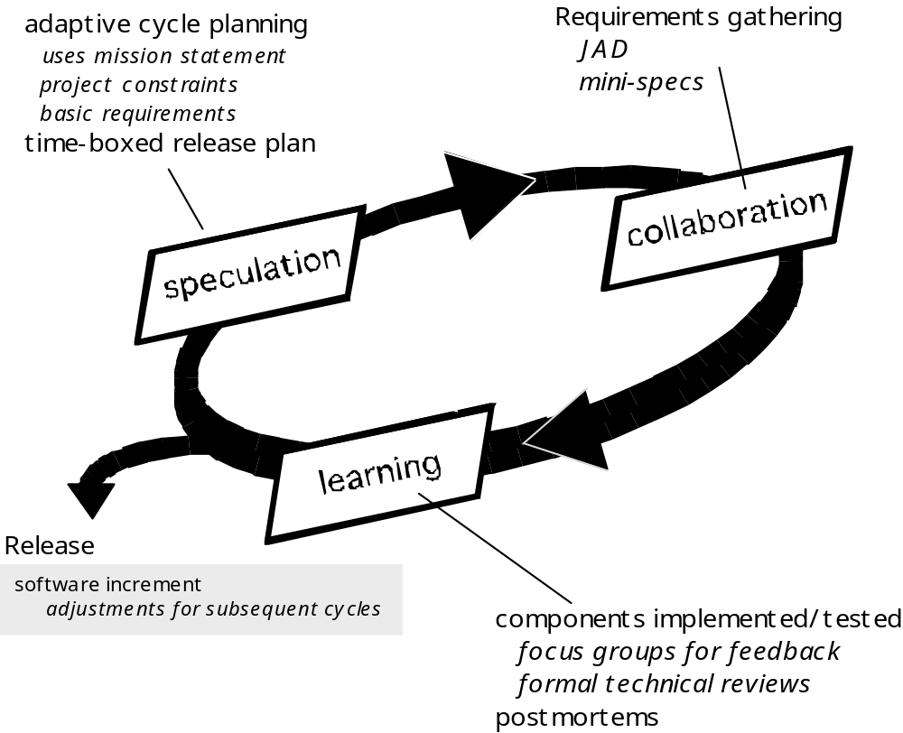
Adaptive Software Development

Slide 12
Dynamic Systems Development Method
Promoted by the DSDM Consortium (www.dsdm.org)
DSDM—distinguishing features
  Similar in most respects to XP and/or ASD
  Nine guiding principles
    Active user involvement is imperative.
    DSDM teams must be empowered to make decisions.
    The focus is on frequent delivery of products.
    Fitness for business purpose is the essential criterion for acceptance of deliverables.
    Iterative and incremental development is necessary to converge on an accurate business solution.
    All changes during development are reversible.
    Requirements are baselined at a high level
    Testing is integrated throughout the life-cycle.

Slide 13
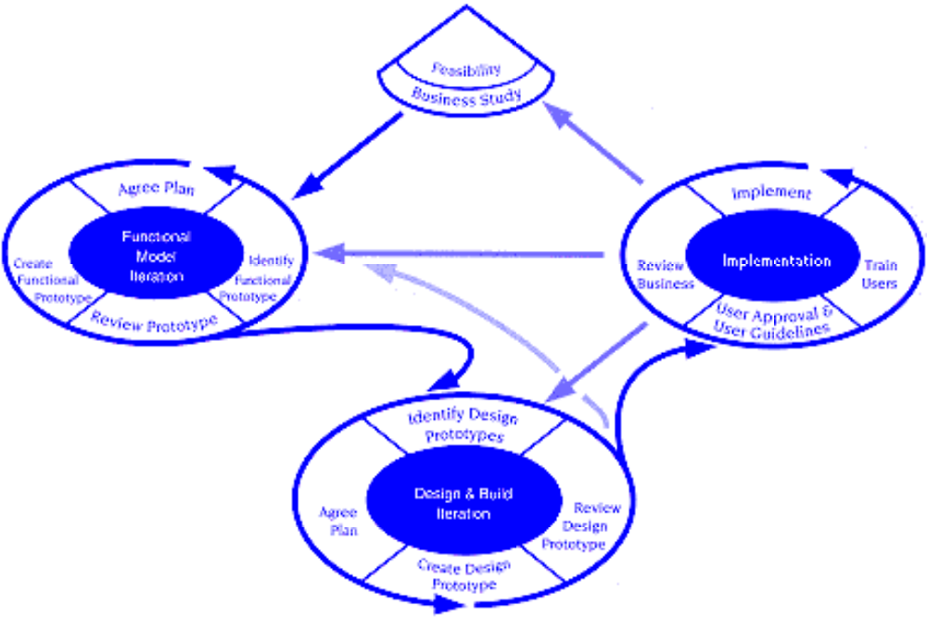
Dynamic Systems Development Method
DSDM Life Cycle (with permission of the DSDM consortium)

Slide 14
Scrum
Originally proposed by Schwaber and Beedle
Scrum—distinguishing features
  Development work is partitioned into “packets”
  Testing and documentation are on-going as the product is constructed
  Work occurs in “sprints” and is derived from a “backlog” of existing requirements
  Meetings are very short and sometimes conducted without chairs
  “demos” are delivered to the customer with the time-box allocated

Slide 15
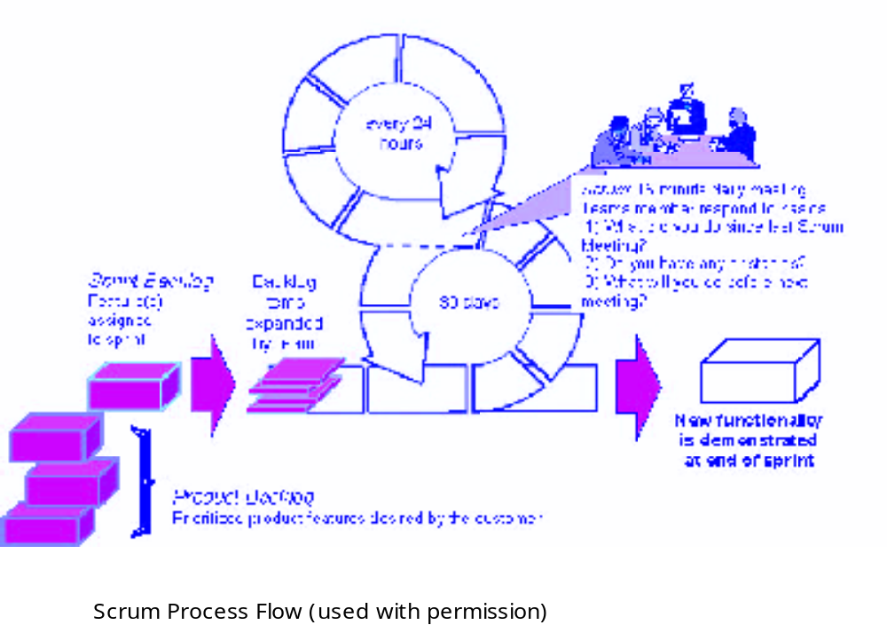
Scrum

Slide 16
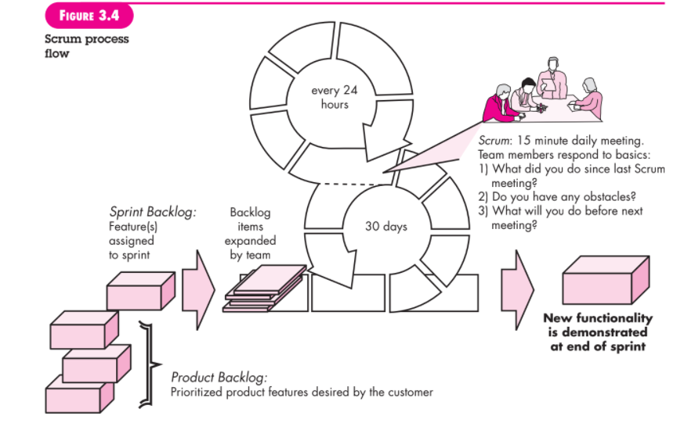

Slide 17
